Slide 1

What’s Next? Analyzing the Data Analyst & Data Scientist Job Market
Francesco Arioli, Marija Matošević, Konstantinos Kallias
13-02-2025

Slide 2

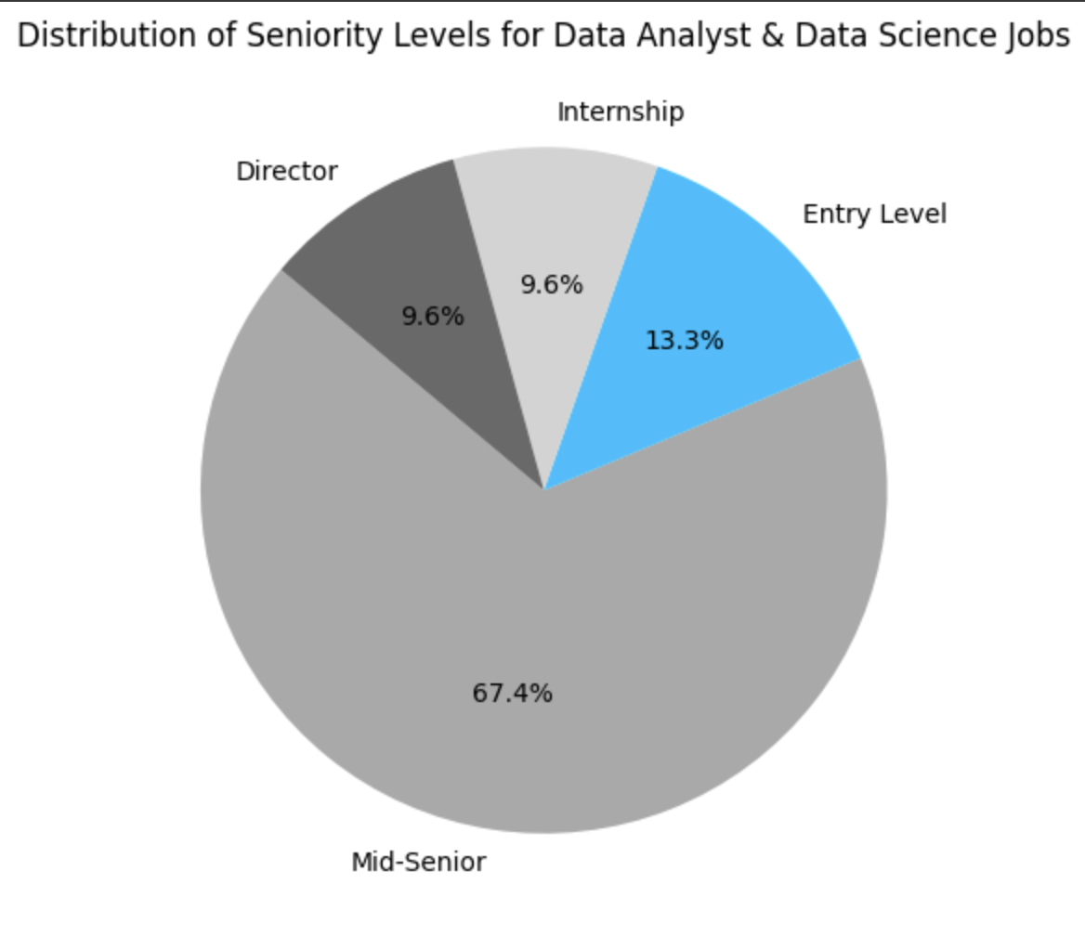
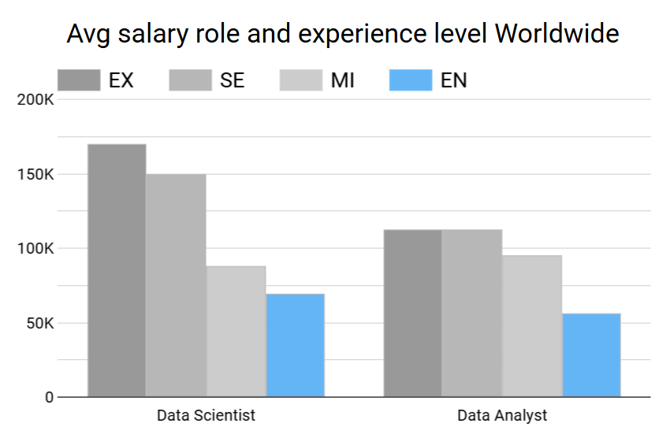
Worldwide background
13-02-2025

Slide 3
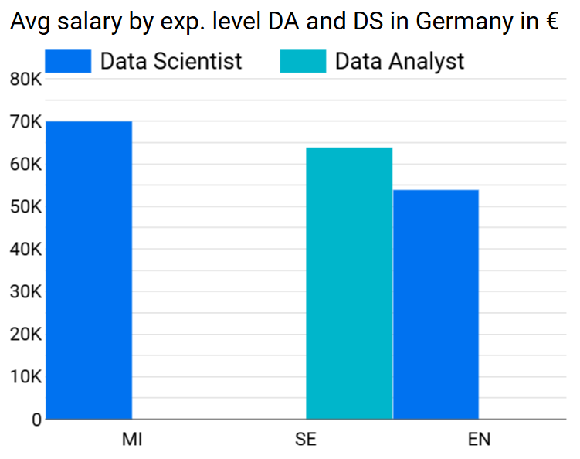
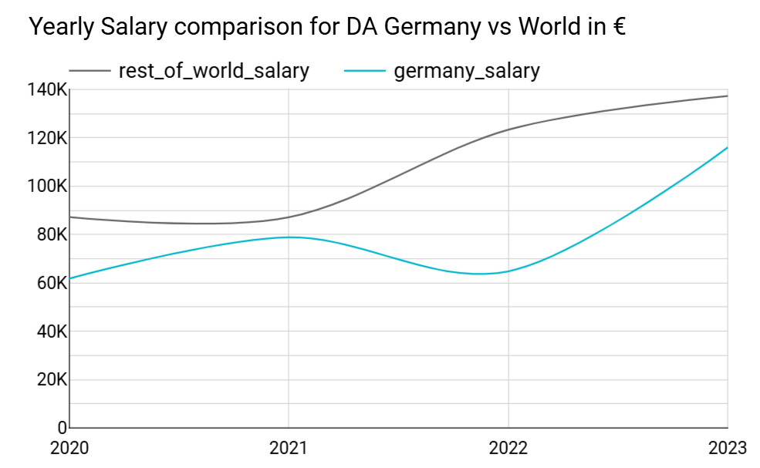
What about Germany?
13-02-2025

Slide 4
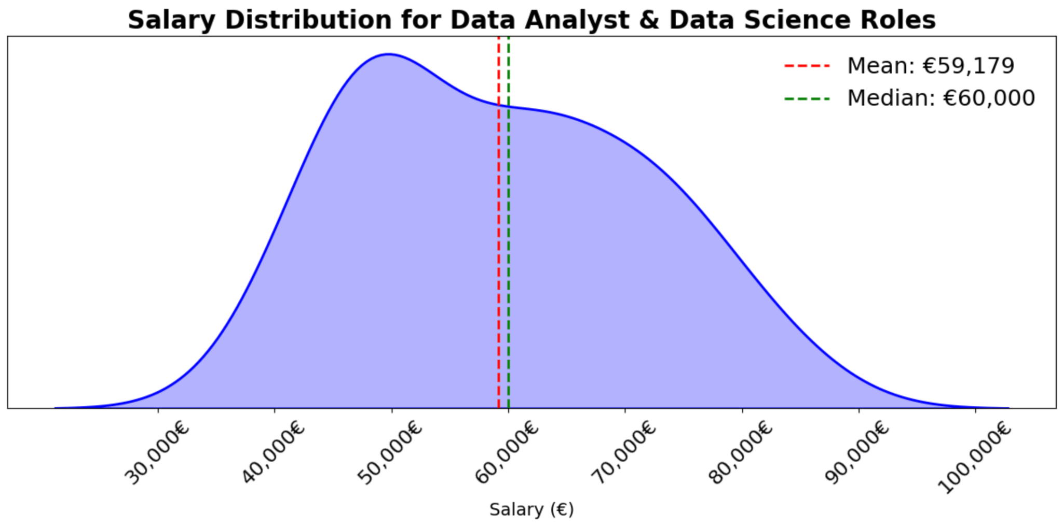
What about Germany?
2025 Predicted ranges
Entry: €42,000 - €63,000
Mid: €63,000 - €95,000
Senior: €95,000 - €160k
average salary increase anywhere from 3% to 7%
13-02-2025

Slide 5
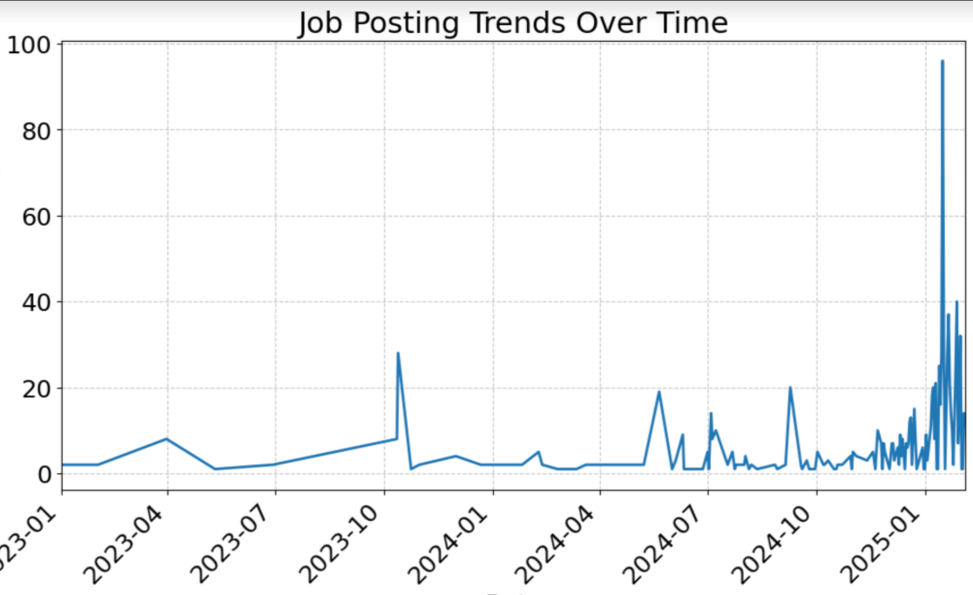
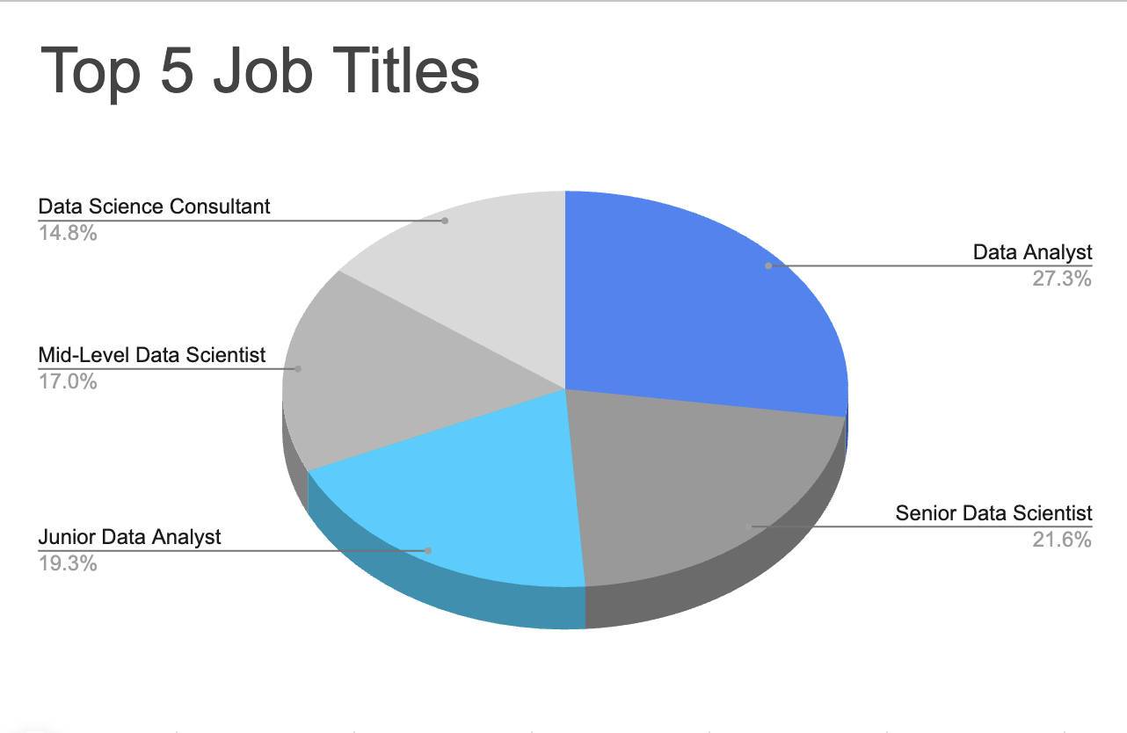
What about Germany?
13-02-2025
Notes:
(This graph shows the number of job postings for Data Analyst and Data Scientist roles over time. The x-axis represents the dates starting from January 2023, while the y-axis shows the number of job postings. The trend line gives a clear view of how job opportunities have changed over time.This visualization helps understand when job postings were at their highest and lowest, giving useful insights into job market trends.)

Slide 6
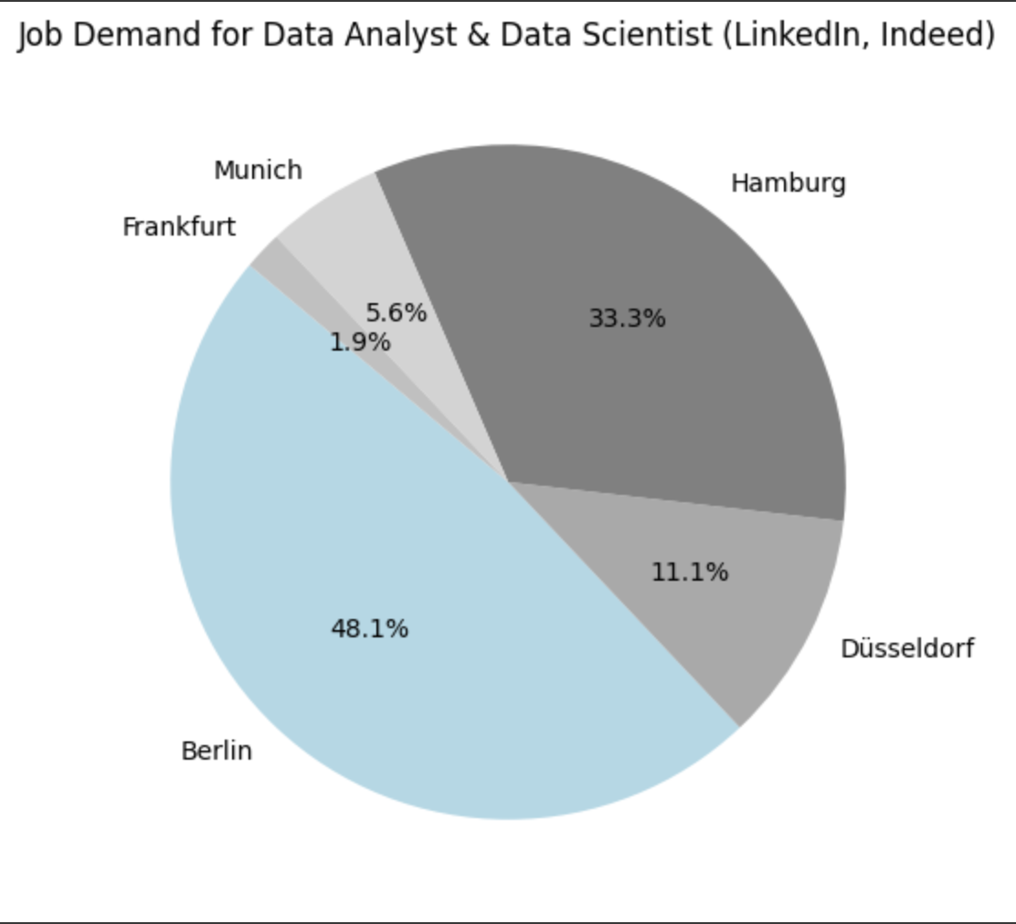
Which cities have more job offers?
13-02-2025

Slide 7
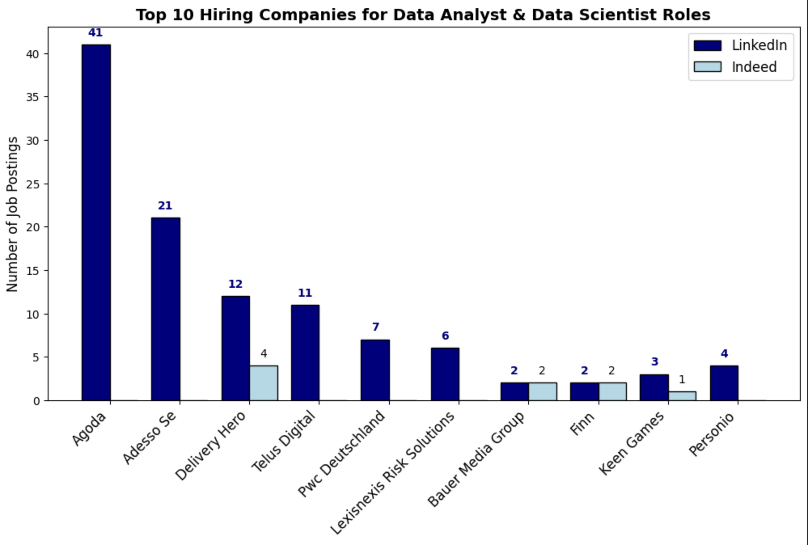
What about companies?
13-02-2025

Slide 8
Final remarks
Demand for Data Analysts & Data Scientists is growing
Salaries are rising
Strong career opportunities ahead
Demand is higher in major cities
Big corporations drive hiring trends
PROS
CONS
13-02-2025

Slide 9
Thank you for your attention!
13-02-2025

